Slide 1
Survey Research
Dirk Riehle, Univ. Erlangen
NYT C10
Licensed under CC BY 4.0 International

Slide 2
Agenda
Survey research
Research questions
Survey design
Survey execution
Survey evaluation

Slide 3
1. Definitions

Slide 4
Definition
Survey a.k.a. questionnaire
A structured quantitative research methodology aimed at gathering information about (one or more) properties of a (large) population
Qualitative survey
A qualitative research methodology based on analysis primary qualitative materials like interviews

Slide 5
Purpose of Survey
The purpose of a survey is to
Gather relevant and representative information
For theory evaluation and validation

Slide 6
Relevant and Representative Information
Information becomes relevant / useful if it
Captures properties of interest correctly
→ You need to define properties and how to measure them
Information becomes representative if
The matching population responds properly
→ You need to define population and how to reach it

Slide 7
Overall Survey Process
Define goals
Design survey
Test survey
Execute survey
Evaluate results

Slide 8
When to Use Survey Research
Research question is well-defined
Clear hypotheses can be expressed
Target population can be defined
Sample population can be reached
Generalization is principally possible
The survey context is well-defined

Slide 9
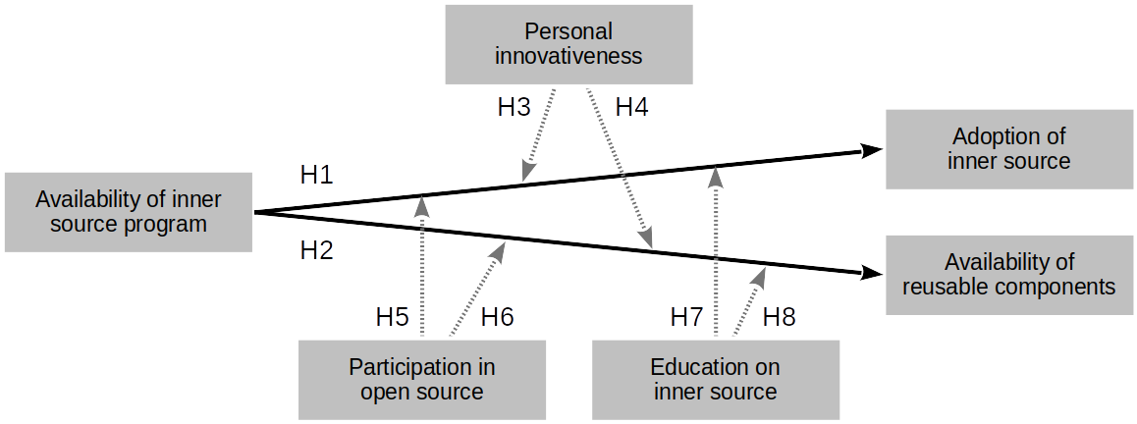
The Hypothesis-Testing Survey

Slide 10
Forms of Survey
Presentation
Online questionnaire
Paper-based questionnaire
Shopping street in-person survey
Content structure
Unstructured
Semi-structured
Structured questionnaire

Slide 11
2. Survey Questions

Slide 12
Types of Questions
A question is a
Measurement instrument for an underlying (theoretical) construct
A construct (recap) is a
Human-made phenomenon
A theoretical construct (recap) is an
Intangible construct

Slide 13
Descriptive Questions
A descriptive question is a question that
Asks about straightforward information
Accepts potential subjectivity in the answer
Used primarily for theory evaluation
Example descriptive questions
Which year were you born?
What is your preferred color?
Do you like to dance?

Slide 14
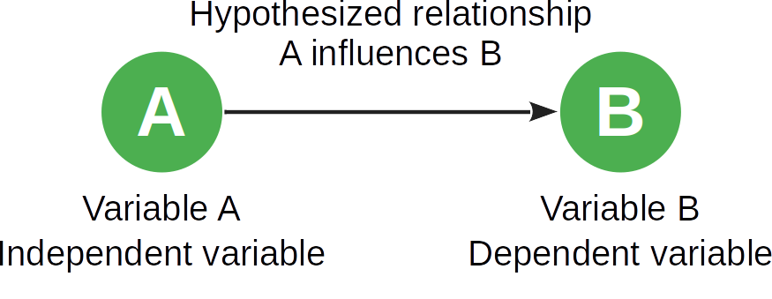
Hypothesis Testing (Recap)

Slide 15
Item Blocks
An item block is a measurement instrument consisting of
A set of questions triangulating the measure of an underlying construct
Tries to get to the essence and avoid participant bias or subjectivity
Used primarily for theory validation
Example item block for “personal innovativeness” [AP98]
If I heard about a new technology, I would look for ways to experiment with it
Among my peers, I’m usually the first to try out new technologies
In general, I am hesitant to try out new technologies
I like to experiment with new technologies

Slide 16
The Creation of Item Blocks
Measurement instruments like item blocks need to be
Developed and calibrated
This is a significant specialized undertaking
A large number of questions are generated
Their expressiveness is tested against a ground truth
The number of questions is reduced to a manageable size

Slide 17
The Use of Item Blocks
Survey creators draw on a large library of item blocks in the literature
They first pick an item block close to their variable
They either use the item block as is (existing variable) or
They vary (within safe limits) the item block to match their need
Example adaptation of innovativeness in IT [AP98] to open-source software
Original instrument for information technology
If I heard about a new information technology, I would look for ways to experiment with it
Among my peers, I’m usually the first to try out new information technologies
In general, I am hesitant to try out new information technologies
I like to experiment with new information technologies
Adjusted instrument for open source software
If I heard about a new technology, I would look for ways to experiment with it
Among my peers, I’m usually the first to try out new technologies
In general, I am hesitant to try out new technologies
I like to experiment with new technologies

Slide 18
Answers to Questions
Qualitative answers are
Plan text
Quantitative answers are
Numerical answers using a scale

Slide 19
Types of Scales
Name | Definition | Examples
Nominal | Provides classes only | { bike, car, ship, … }
Ordinal | Adds rank ordering of values | 1st prize, 2nd prize, 3rd prize
Interval | Adds distance to values | Temperature
Ratio | Adds ratios to values | Prices for goods

Slide 20

Quiz: What Type of Scale is the Likert Scale?
A five-point Likert scale looks like this
Disagree
Somewhat disagree
Neutral
Somewhat agree
Agree
What type of scale is this?

Slide 21
Types of Surveys
A descriptive survey is a questionnaire with
Questions gathering descriptive information about the population
A hypothesis-testing survey is a questionnaire
Testing at least one hypothesis

Slide 22
3. Survey Design

Slide 23
Sections of a Survey
Preamble
Demographics
Main body
Closing

Slide 24
Preamble
The survey preamble creates informed consent
What is the survey about?
Introduction and purpose
What to expect when taking it?
Duration, experiences
Who is responsible?
Where to ask questions?
Where to complain?
And may offer a non-confounding incentive to take the survey

Slide 25
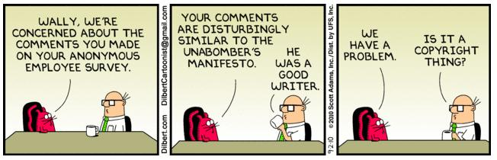
Dilbert on Survey Ethics [1]
[1] See …

Slide 26
Demographics
The demographics section profiles the respondent
In an anonymous way
To create context
Typical demographics questions are descriptive
Which year were you born?
What is your primary job function?
What is your highest level of education?

Slide 27
Main Body of Survey
The main body consists of one or more sections
Measuring variables using
Descriptive questions
Item blocks
The variables are derived from a research model and its hypotheses

Slide 28
Closing
The closing section marks the end of the survey
It may offer self-disclosure (e.g. email address) of respondent
To receive information about the survey result
To receive the incentive

Slide 29
Survey Logic
You often can add if-then-else paths through the questionnaire

Slide 30
What Can Possibly Go Wrong?
Respondents misunderstand your questions
Questions are ambiguous, allowing for several valid interpretations

Slide 31
Test Your Survey!
Test your survey with friends and colleagues or selected samples from your population

Slide 32
4. Survey Execution

Slide 33
Survey Execution
The strategic approach
Define sampling model
Sample population
Reach out
The convenience approach
Blast on all channels

Slide 34
What Can Possibly Go Wrong?
Respondents don’t finish because
The survey has too many questions

Slide 35
5. Survey Evaluation

Slide 36
Survey Evaluation
Test your hypotheses

Slide 37
Summary
Definitions
Survey questions
Survey design
Survey execution
Survey evaluation

Slide 38
Thank you! Any questions?
dirk.riehle@fau.de – https://oss.cs.fau.de
dirk@riehle.org – https://dirkriehle.com – @dirkriehle

Slide 39
Legal Notices
License
Licensed under the CC BY 4.0 International license
Copyright
© Copyright 2022 Dirk Riehle, some rights reserved

